Slide 1




USING STATIC ANALYSIS TO IMPROVE EFFICIENCY OF PROGRAM ANALYSIS
Idriss Riouak
Student Research Competition
<Programming>24

Slide 2
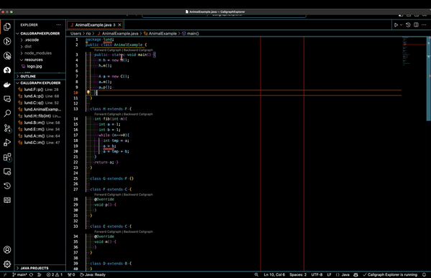
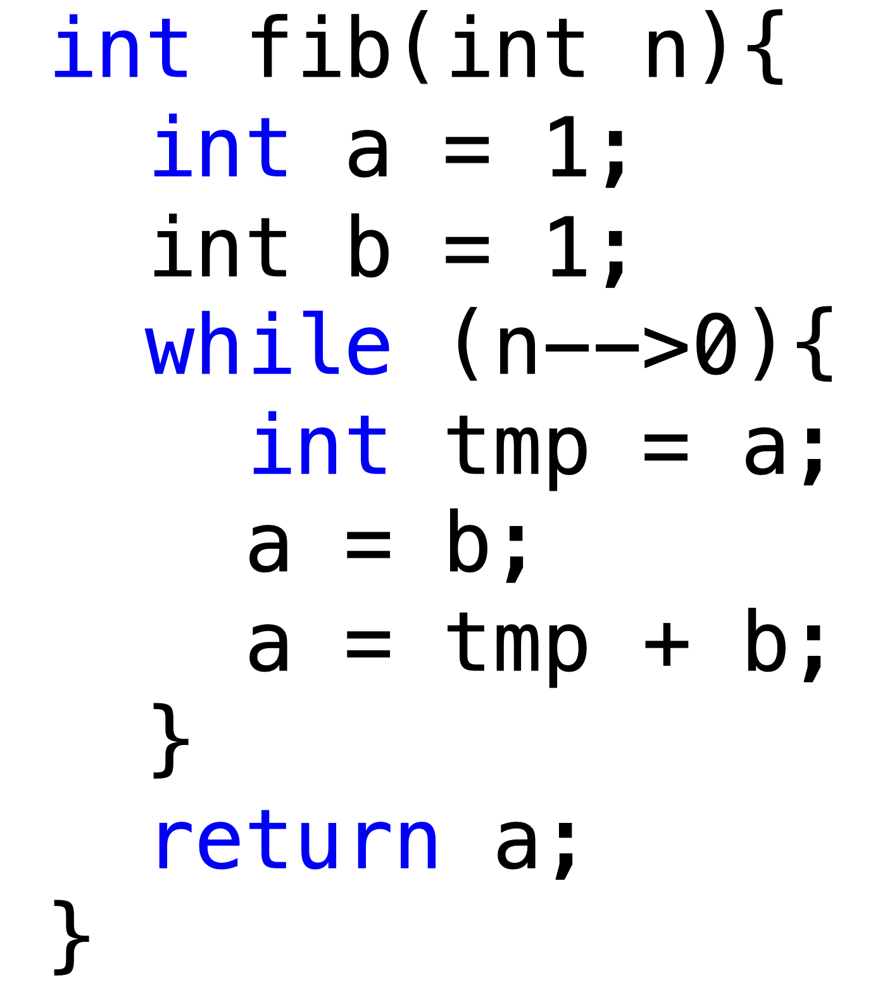
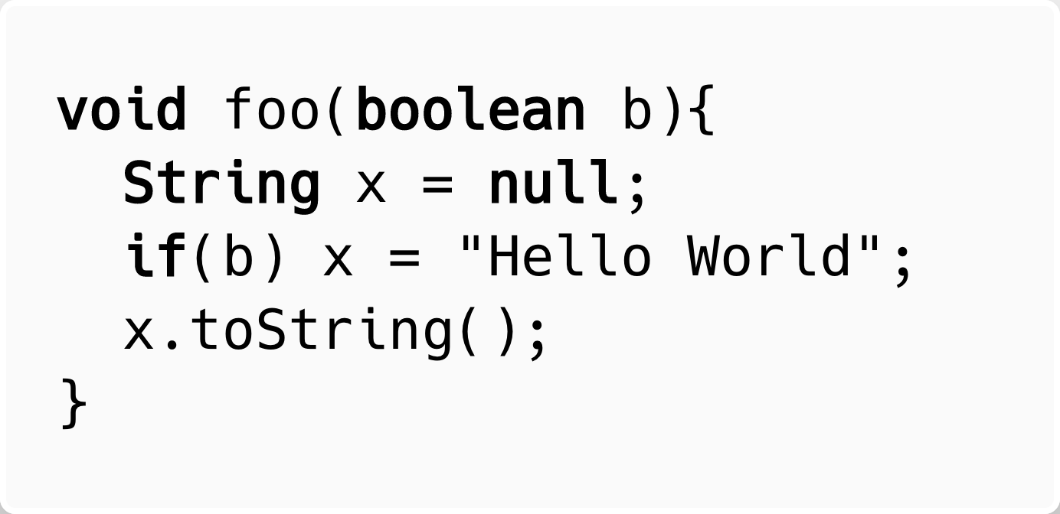
Static Analysis
We can use static analysis to detect common weaknesses:
… but also for code comprehension
🐛
‘a=b’ is dead
🐛
‘x’ might be null
Notes:
Static program analysis is the art of reasoning about a program’s behaviour and properties without executing it.

Slide 3


Shifting-left static analysis
👮‍♀️
👩‍💻

Slide 4
How to implement a static analyzers ?
Imperative way:
How to do the analysis and how to compute the result
The implementation details are a responsability of the developer
Declarative way:
What the analysis result should be
The implementation details are delegate to the compiler.
Reference Attribute Grammars

Slide 5
Attributes
Attributes are side-effect-free properties associated with Abstract Syntax Tree (AST) nodes.
foo
String x = null
IF
Dot
Type and name analysis are usually computed as properties
e.g., decl()
b
=
x
toString()
decl()
decl()
x
“Hello World”
Notes:
You can think of an attribute like a function.

Slide 6
JastAdd
JastAdd is an attribute grammar system for Java.
Many projects use JastAdd:
ExtendJ (Java 11 compiler)
IntraJ (Intraprocedural dataflow analyses)
Soot (Java static analyser)
CAT (Callgraph Analysis Tool)
...

Slide 7
Circular Attributes
We say that an attribute is circular if its value may depend on itself directly of indirectly
fib
int fib(int n){
int a = 1;
int b = 1;
while (n-->0){
int tmp = a;
a = b;
a = tmp + b;
}
return a;
}
int a, b = 1
while
...
deadAssign()
🐛
n-->0
deadAssign()
int tmp = a
a = b
a = tmp + b
deadAssign()
deadAssign()
deadAssign()
Circular attributes require computing a fixed point.
Fixpoint computation are expensive
Efficient Demand Evaluation of Circular Attributes Using Static Analysis

Slide 8
Circular Attributes
We say that an attribute is circular if its value may depend on itself directly or indirectly
fib
int fib(int n){
int a = 1;
int b = 1;
while (n-->0){
int tmp = a;
a = b;
a = tmp + b;
}
return a;
}
int a, b = 1
while
...
deadAssign()
n-->0
deadAssign()
int tmp = a
a = b
a = tmp + b
deadAssign()
deadAssign()
deadAssign()
Circular attributes require computing a fixed point.
Fixpoint computation are expensive

Slide 9
The fixpoint algorithm is not exposed to the developer
How do we generate an efficient fix-point algorithm ?

Slide 10

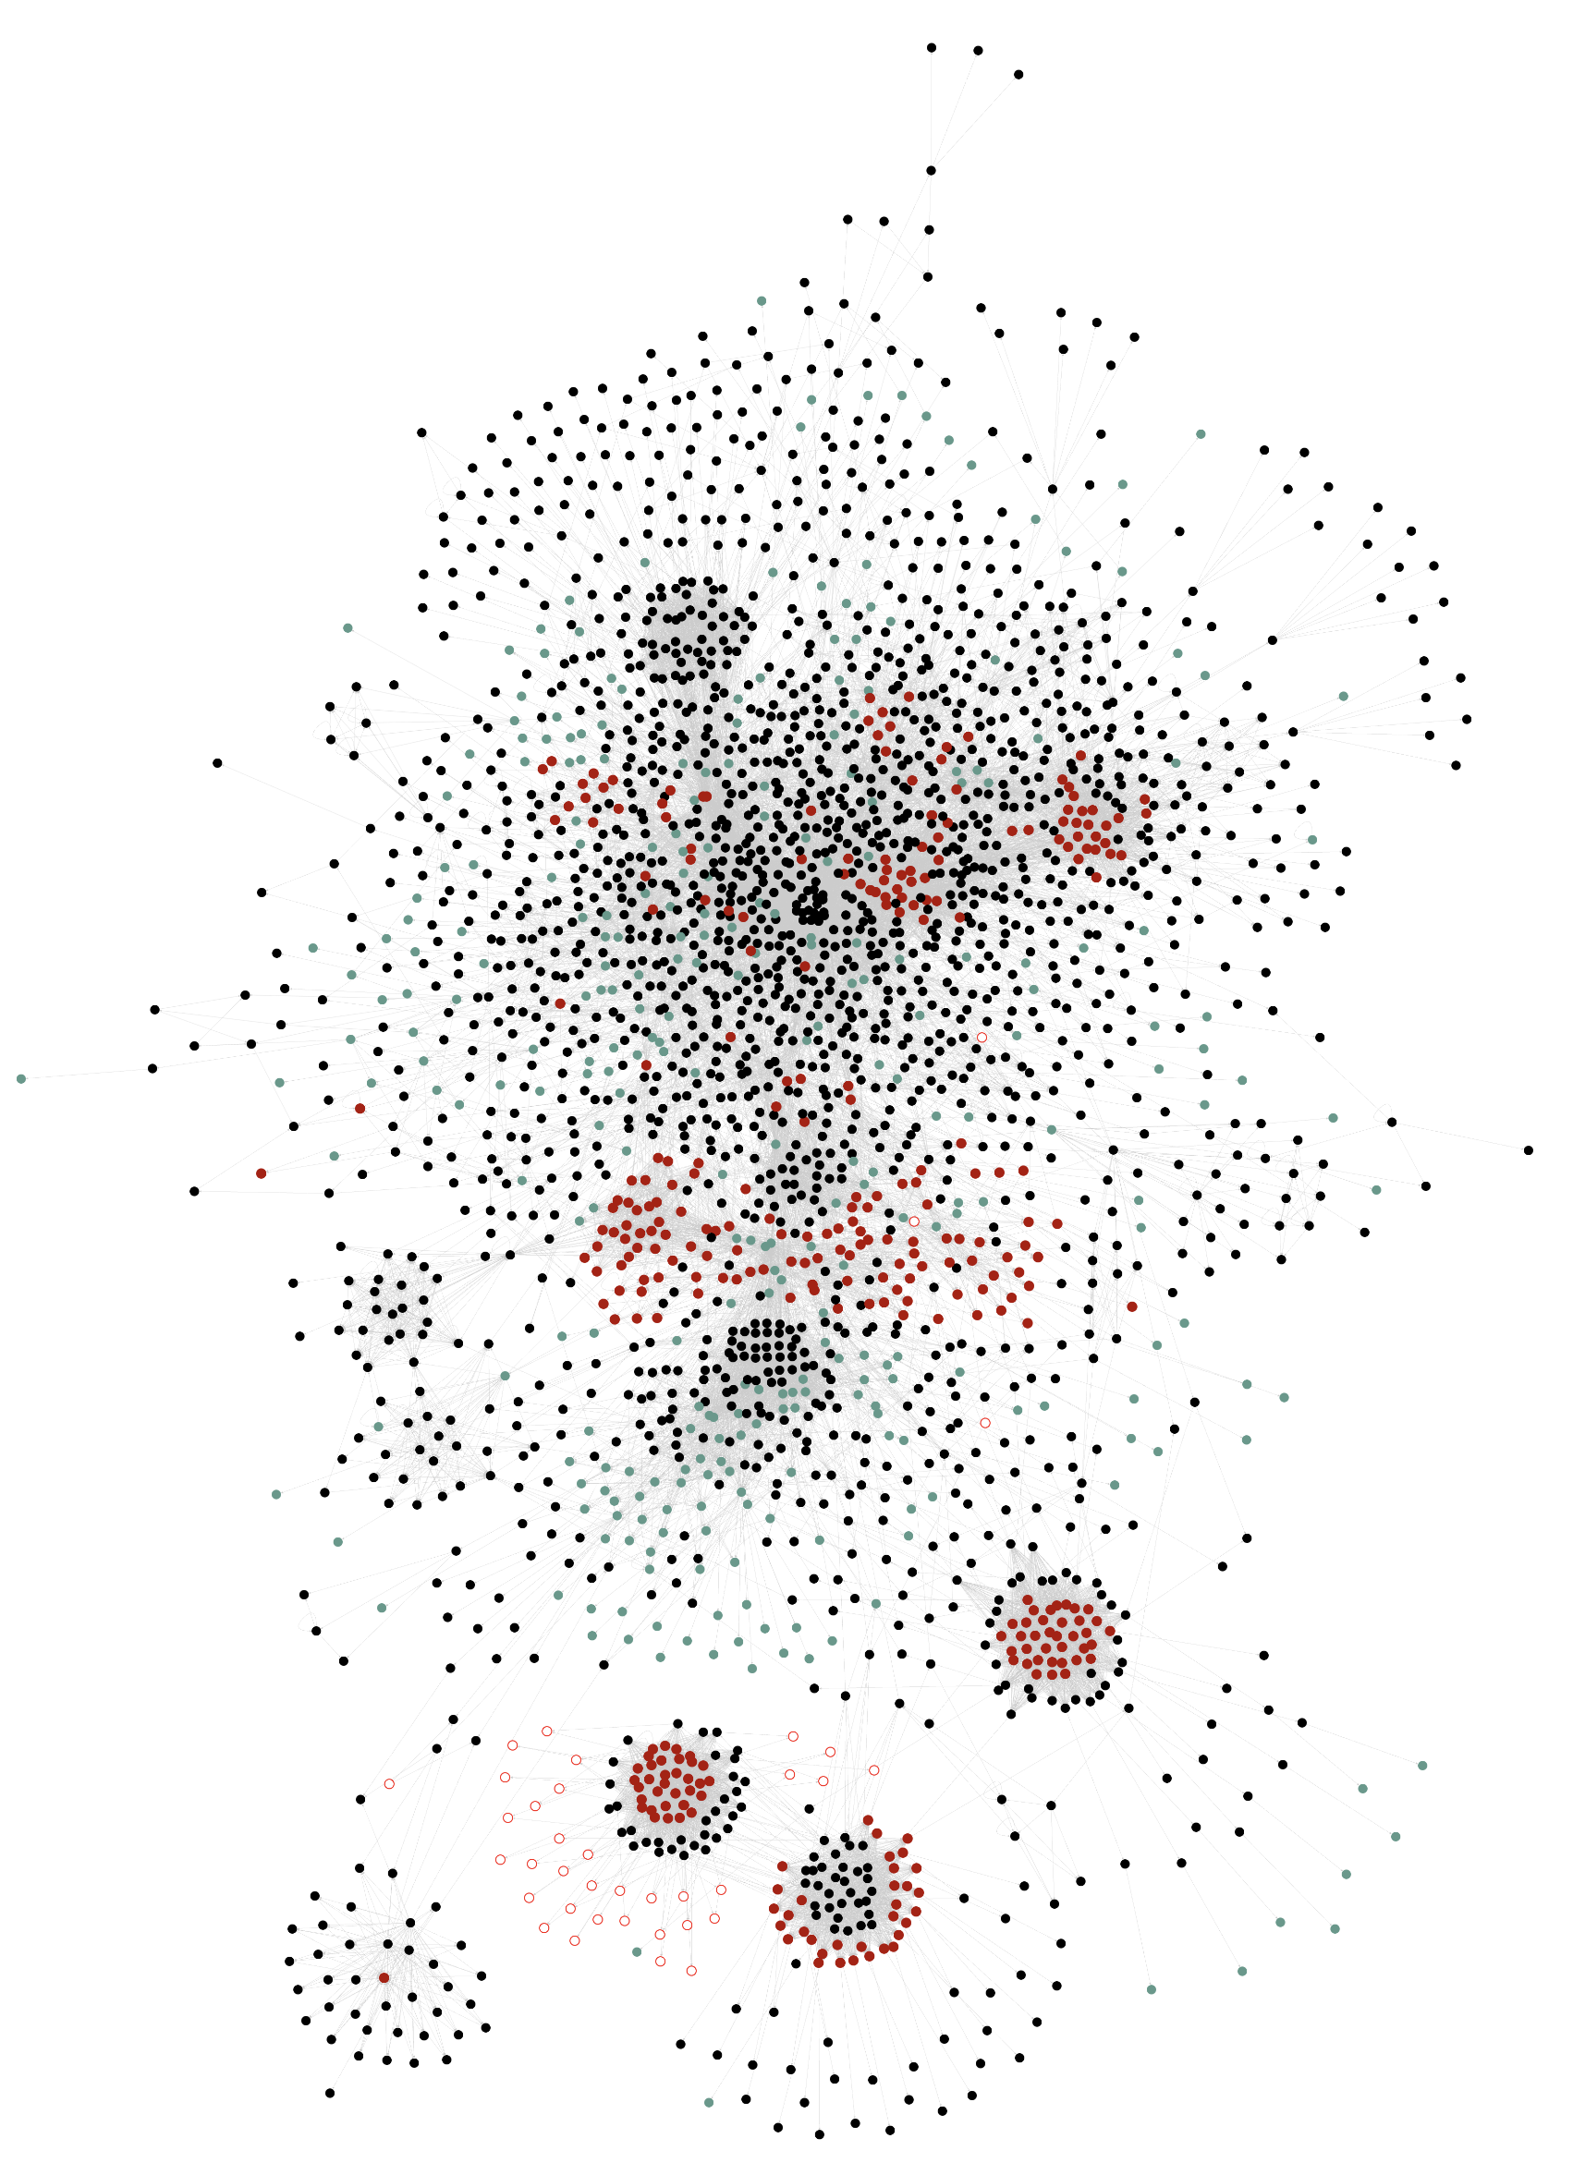
Circular Attributes
We say that an attribute is circular if its value may depend on itself directly of indirectly
Circular attributes require computing a fixed point.
Fixpoint computation are expensive
RelaxedMonolithic was proposed by Öqvist et. al:
Main problem:
At runtime the algorithm is not able to distinguish between circular and non-circular attributes
BasicStacked reqired all the attributes involved in the circular evaluation to be explicitly marked as circular.
2 main problems:
Some attributes exhibit circular behavior occasionally but we still pay for a costly fix-point computation.
For example, the Type() attribute in Java is non-circular 90% of the inputs and circular for the remaining 10%.
Annotating each attribute is infeasable for large projects.
NO
NO
YES
YES
YES
NO
YES
YES
YES
Algorithm | Low engineering effort? | Can handle occasionally circular attribute efficiently ? | Can efficiently cache attribute in presence of multiple fixpoint ?
BasicStacked
RelaxedMonolithic
RelaxedStacked (our)
Start
C
Converges in 20 iteration.
C
Non-circular. No fix-point computation required.
N
C
C
Converges in 10 iteration.
Efficient Demand Evaluation of Circular Attributes Using Static Analysis

Slide 11
Circular Attributes
We say that an attribute is circular if its value may depend on itself directly of indirectly
Circular attributes require computing a fixed point.
Fixpoint computation are expensive
NO
NO
YES
YES
YES
NO
YES
YES
YES
Algorithm | Low engineering effort? | Can handle occasionally circular attribute efficiently ? | Can efficiently cache attribute in presence of multiple fixpoint ?
BasicStacked
RelaxedMonolithic
RelaxedStacked (our)
Efficient Demand Evaluation of Circular Attributes Using Static Analysis

Slide 12
Problem: Engineering effort & Efficiency
BasicStacked proposed by Magnusson et. al.
2 main problems:
Some attributes exhibit circular behavior occasionally but we still pay for a costly fix-point computation.
For example, the Type() attribute in Java is non-circular 90% of the inputs and circular for the remaining 10%.
Annotating each attribute is infeasable for large projects.
Complexity of the ExtendJ Java Compiler.
2597 Attributes connected by 26222 edges

Slide 13
Problem: Efficiency
RelaxedMonolithic was proposed by Öqvist et. al:
Required having at least one attribute marked as circular in each circular evaluation
Main problem:
At runtime the algorithm is not able to distinguish between circular and non-circular attributes
The fixpoint evaluation is performed in a single monolithic fix point computation
Start
C
Converges in 20 iteration.
C
Non-circular. No fix-point computation required.
N
C
C
Converges in 10 iteration.

Slide 14
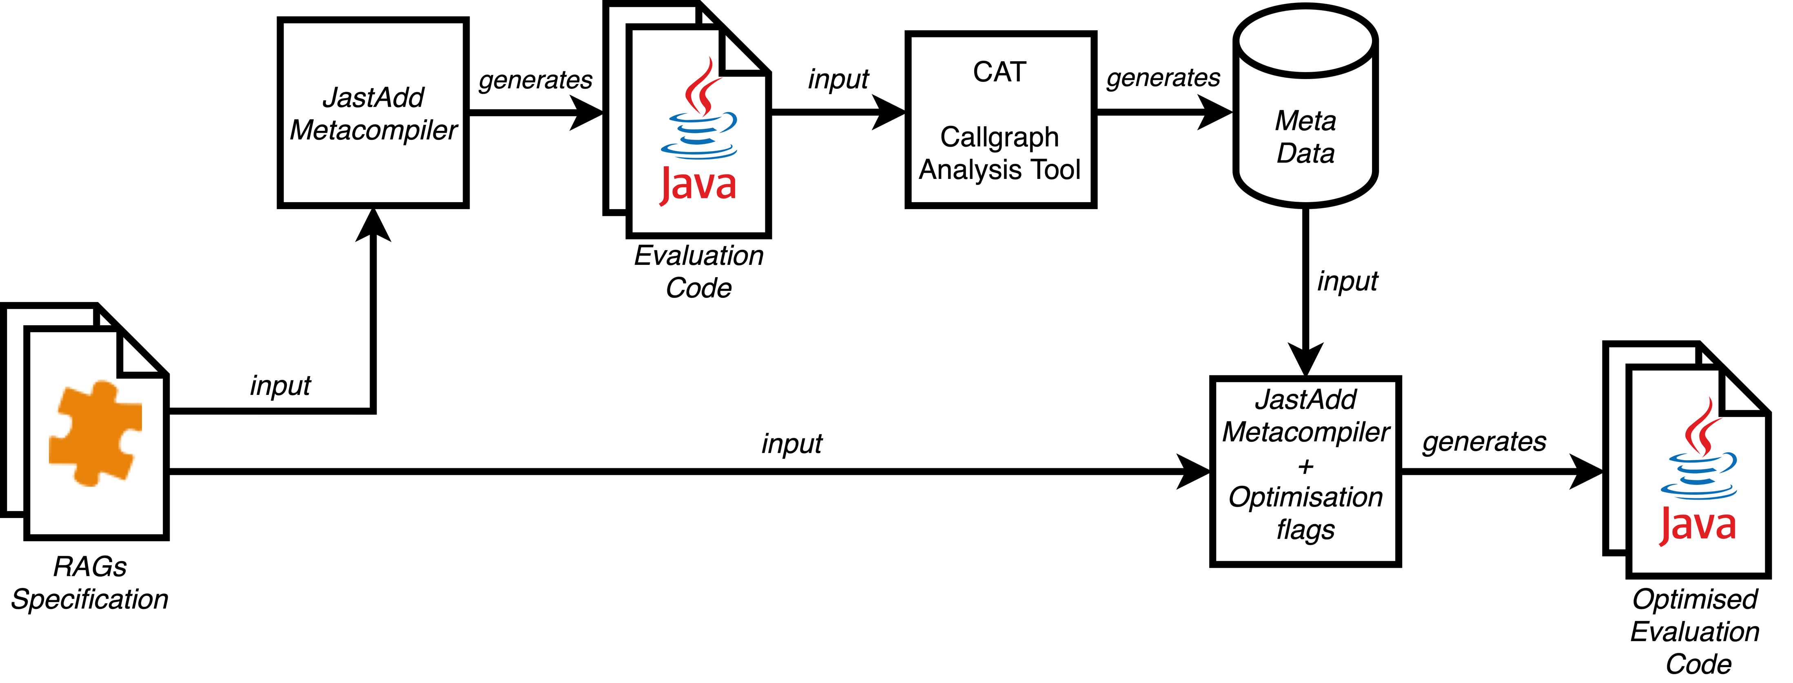
Our Approach
We propose a new approach that can immedialty cache non-circular attribtues, avoiding unnecessary recomputations.

Slide 15
Our Approach
We propose a new approach that can immedialty cache non-circular attribtues, avoiding unnecessary recomputations.

Slide 16
Our Approach
We propose a new approach that can immedialty cache non-circular attributes, avoiding unnecessary recomputations.

Slide 17
Our Approach
We propose a new approach that can immedialty cache non-circular attribtues, avoiding unnecessary recomputations.

Slide 18
Our Approach
We propose a new approach that can immedialty cache non-circular attribtues, avoiding unnecessary recomputations.

Slide 19

Simple Example
The JastAdd metacompiler generates Java code.
We construct an overapproximation of the program’s callgraph using CAT.
We compute SCCs and we identify non-circular attributes.
We feed back this information to JastAdd to generate more efficient code.
non-circular
N
A
C
C
B
D
E
C
non-circular
A
Pause on-going
evaluation
N
non-circular
non-circular
B
D
E
C
C

Slide 20
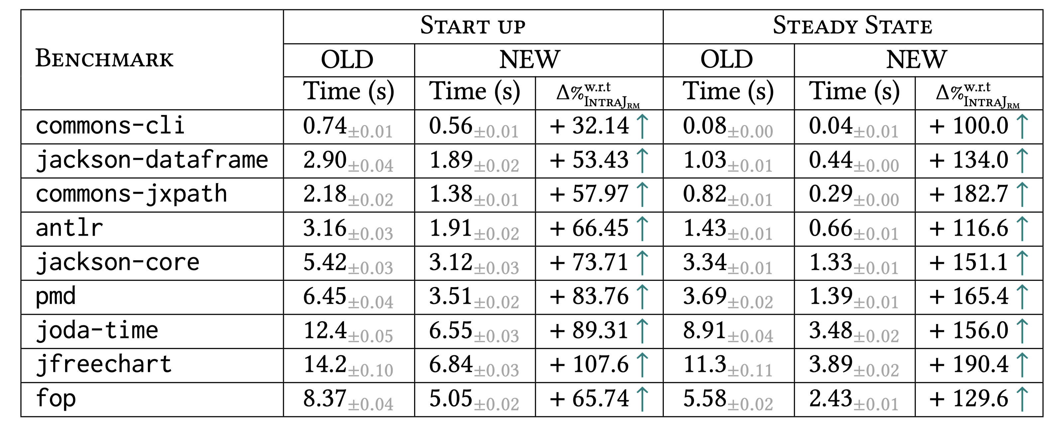
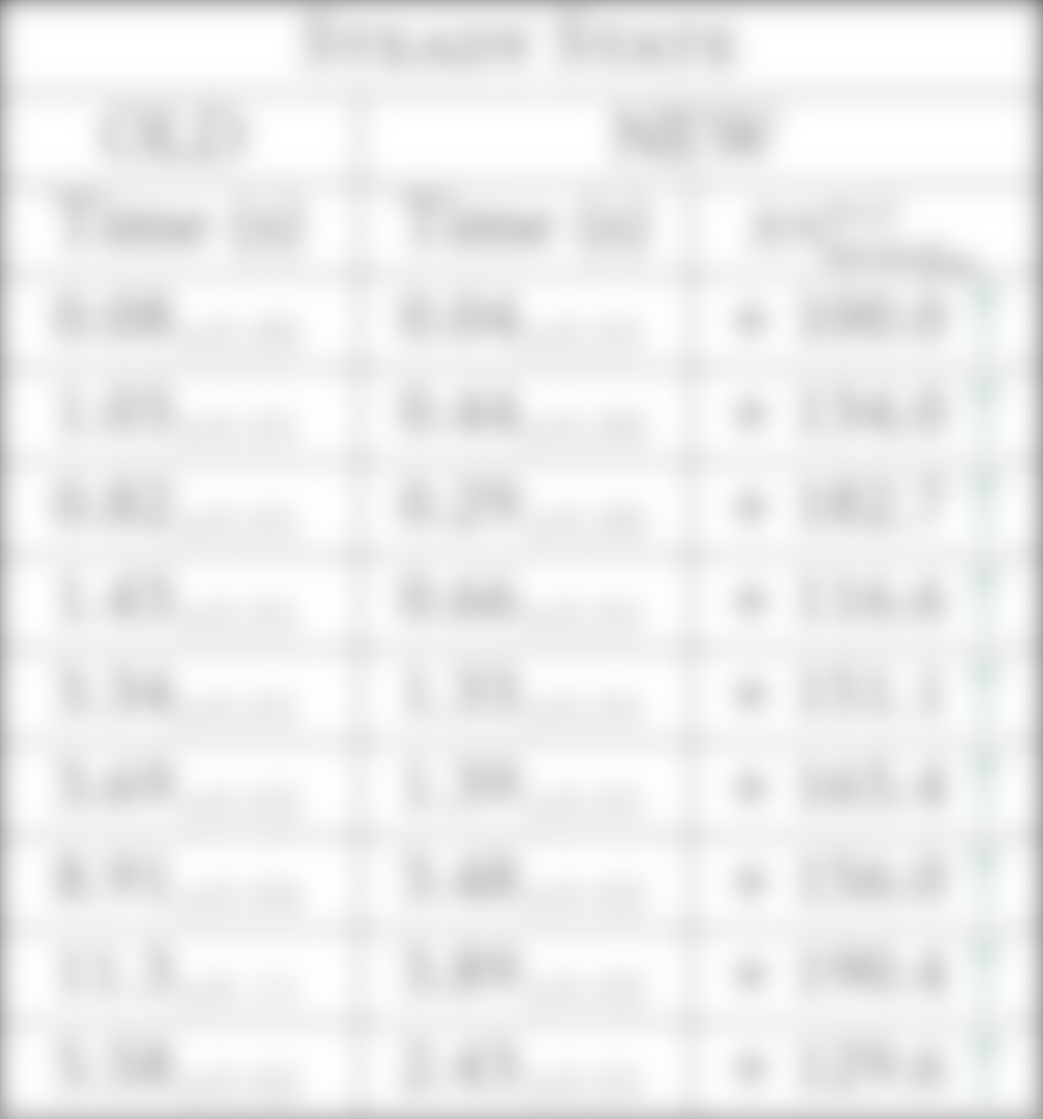
Results
We conducted experiments on IntraJ, a Java static analyzer supporting dataflow analyses such as Dead Assignment and Null Pointer Exception Analysis. Below the results for Dead Assignment Analysis:

Slide 21
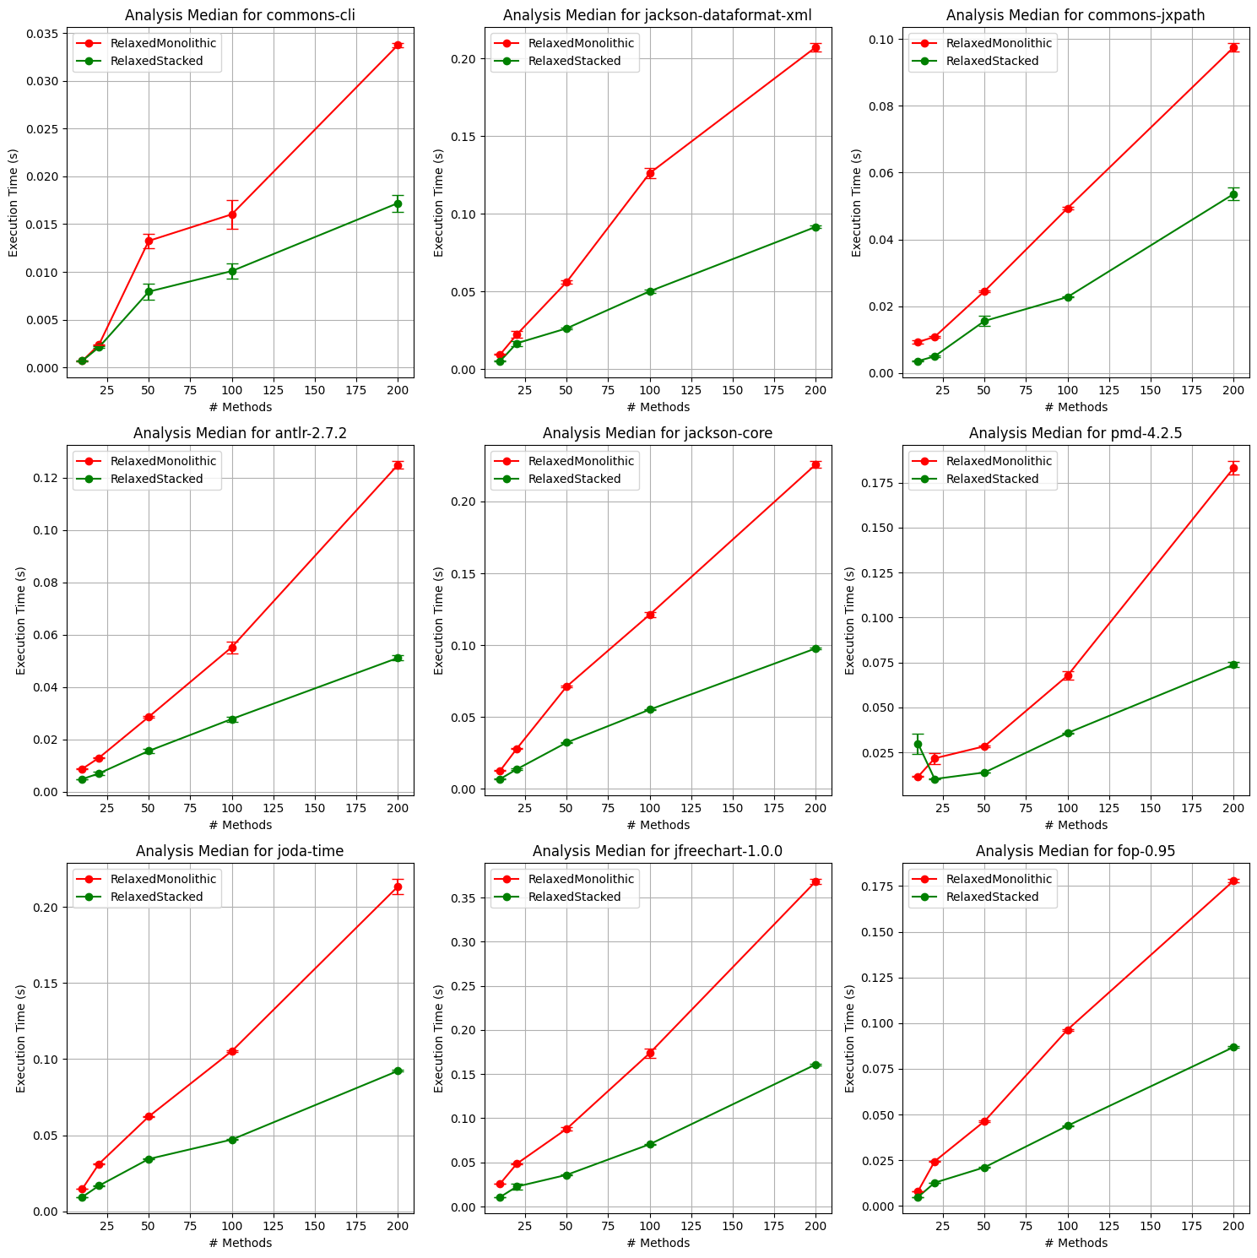
Results
Randomly selected methods:
We analysed 10 – 20 -50 - 100 – 200 methods.

Slide 22

Any Questions ?
CONTEXT
Dataflow problems can be expressed at a high level using circular attributes. Demand-driven fixed-point implementations can be automatically generated, suitable for compilers and language tooling.
PROBLEM
Existing algorithms assume all attributes in a fixed-point computation to be (potentially) circular, leading to inefficiencies.
SOLUTION
Our new algorithm uses static analysis to identify attributes that are guaranteed to never be circular.
Our results show a significant speedup of 100% (start-up) and 190% (steady-state) for dataflow analysis in a Java compiler.
USING STATIC ANALYSIS TO IMPROVE EFFICIENCY OF PROGRAM ANALYSIS
Model: Brioche
Inspired by Philip’s talk this morning:
A cat photo concludes any
presentation purr-fectly.

Slide 23
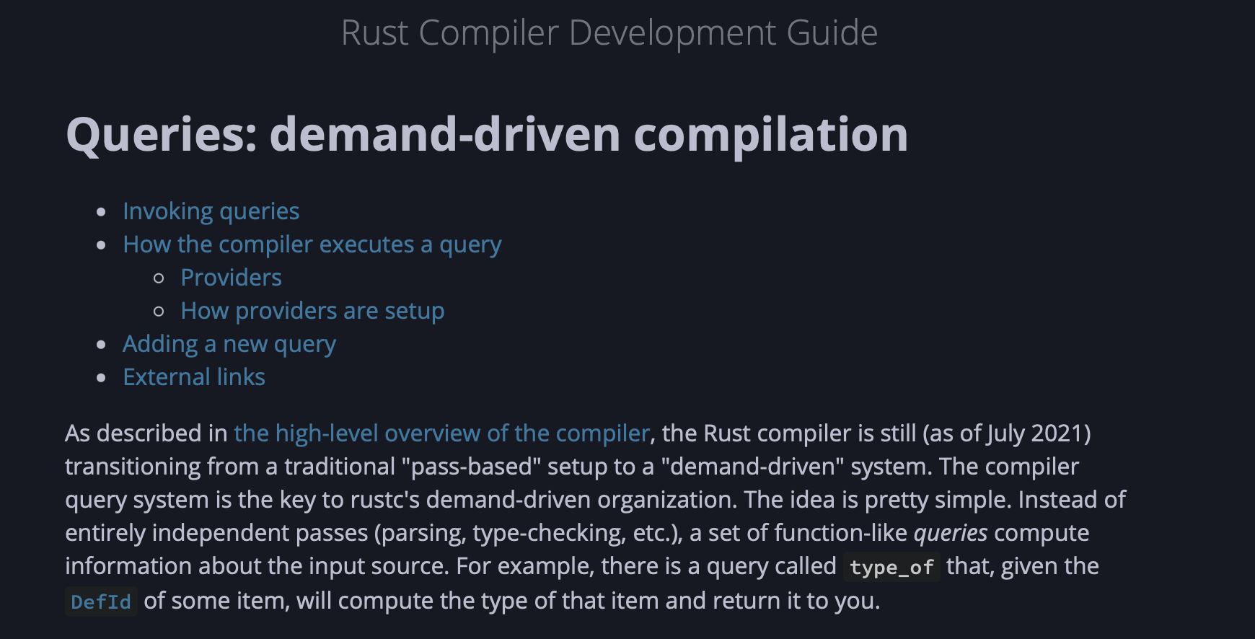
Direct impact
Potential impact
Many different projects use RAGs:
ExtendJ
IntraJ
JavaDL – Datalog static analyser
Progger
Bloqqi - DSL used @ ABB
Used @ Modelon
CAT – Call Graph Analysis Tool
…
Other Attribute Grammars Systems that could
benefit from this:
Silver (Java)
Haskell library
Query based compiler, where caching is essential:
Rustc compiler is moving towards that direction
Roslyin: C# compiler is using a concept very similar
Attributes

Slide 24
Imperative vs Declarative
Imperative: (possibly) very fast but error-prone.
Declarative: (most of the time) slow. Modularity, easy-to-understand code

